Slide 1
EMTH403
Mathematical Foundation for Computer Science

Slide 2
Lecture Outcomes
understand what Spanning Trees.
understand what is Prim’s Algorithm.

Slide 3
Spanning Trees
A spanning tree of a graph is just a subgraph that contains all the vertices and is a tree.
A graph may have many spanning trees.
Graph A
Some Spanning Trees from Graph A
or
or
or

Slide 4
Spanning Trees
Complete Graph
All 16 of its Spanning Trees

Slide 5
Minimum Spanning Trees
The Minimum Spanning Tree for a given graph is the Spanning Tree of minimum cost for that graph.
Complete Graph
Minimum Spanning Tree
7
2
2
5
3
3
4
1
1

Slide 6
Spanning Trees
Central office

Slide 7
Spanning Trees
Central office
Expensive!

Slide 8
Spanning Trees
Central office
Minimize the total length of wire connecting the customers.

Slide 9
Algorithms for Obtaining the Minimum Spanning Tree
Kruskal's Algorithm
Prim's Algorithm

Slide 10
Spanning Trees
Prim’s algorithm: Start with any one node in the spanning tree, and repeatedly add the cheapest edge, and the node it leads to, for which the node is not already in the spanning tree.
  Here, we consider the spanning tree to consist of both nodes and edges

Slide 11
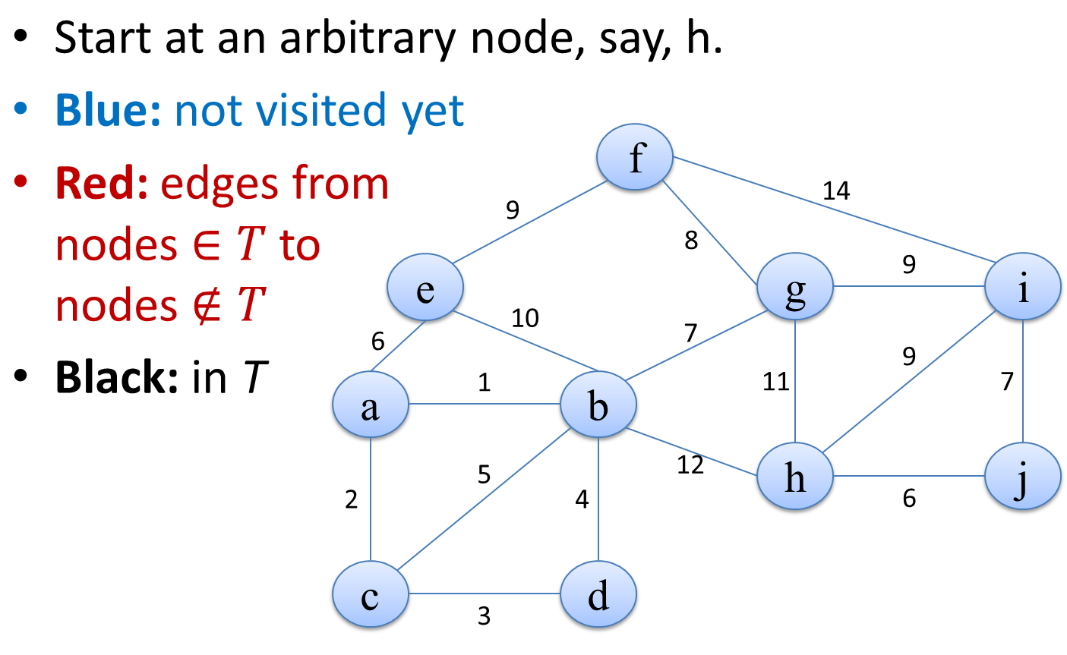
Prim’s algorithm

Slide 12
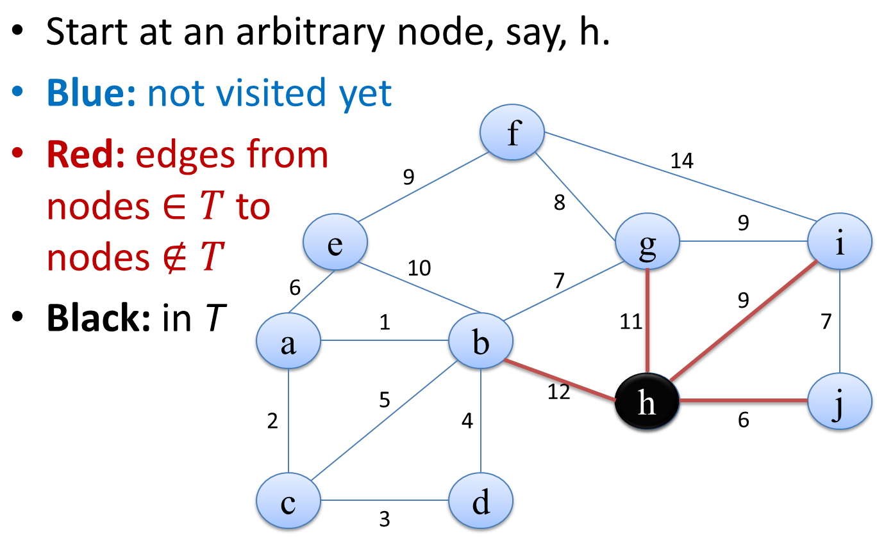
Prim’s algorithm

Slide 13
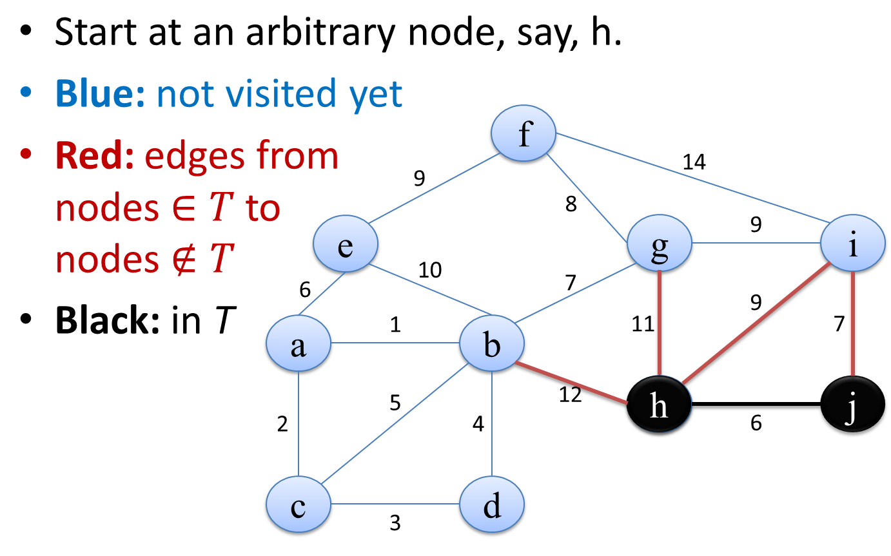
Prim’s algorithm

Slide 14
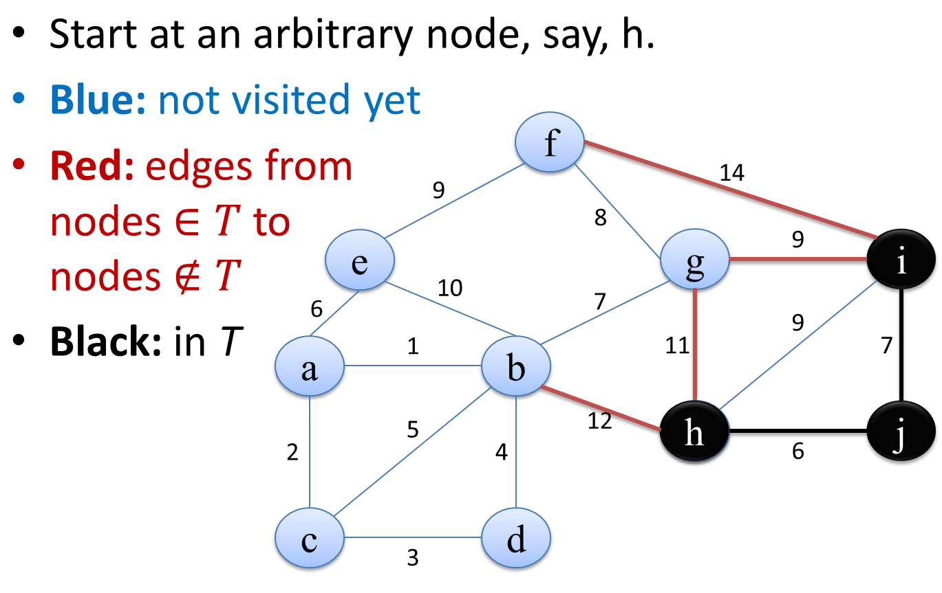
Prim’s algorithm

Slide 15
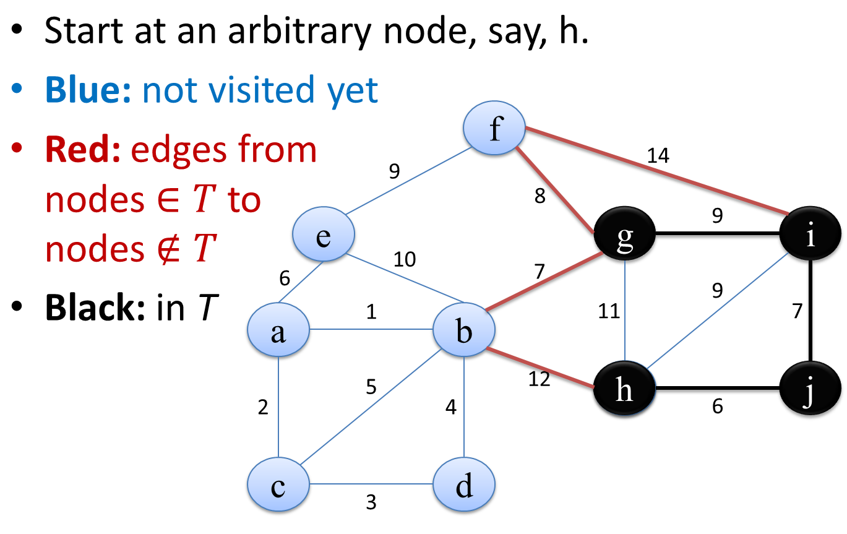
Prim’s algorithm

Slide 16
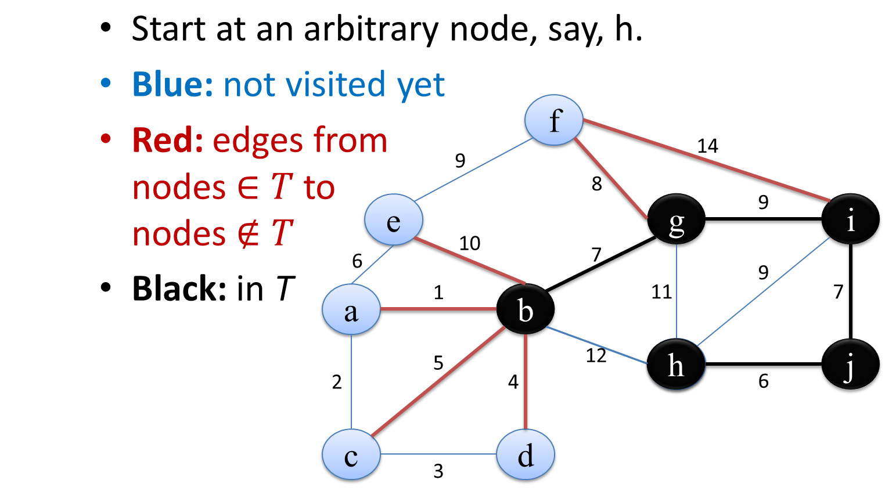
Prim’s algorithm

Slide 17
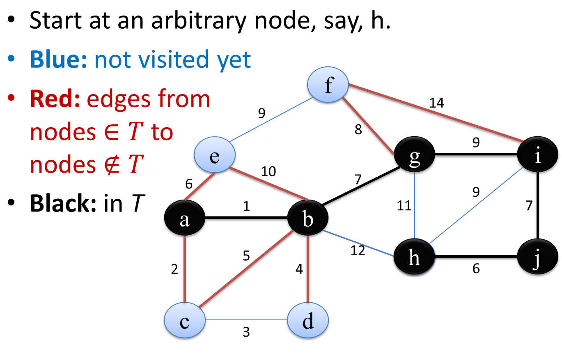
Prim’s algorithm

Slide 18
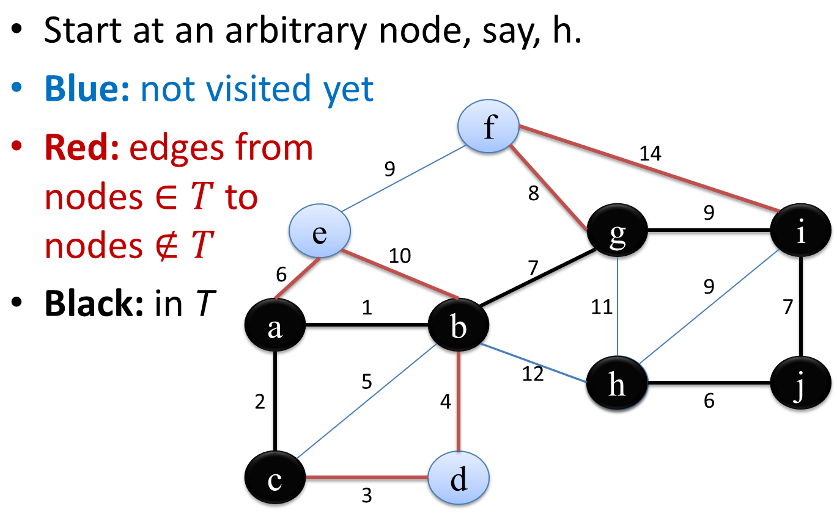
Prim’s algorithm

Slide 19
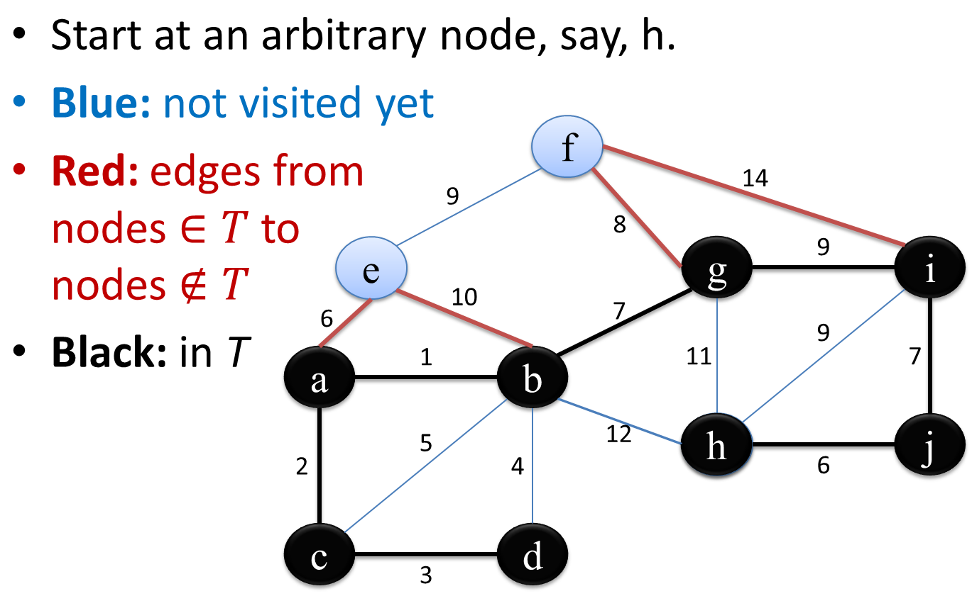
Prim’s algorithm

Slide 20
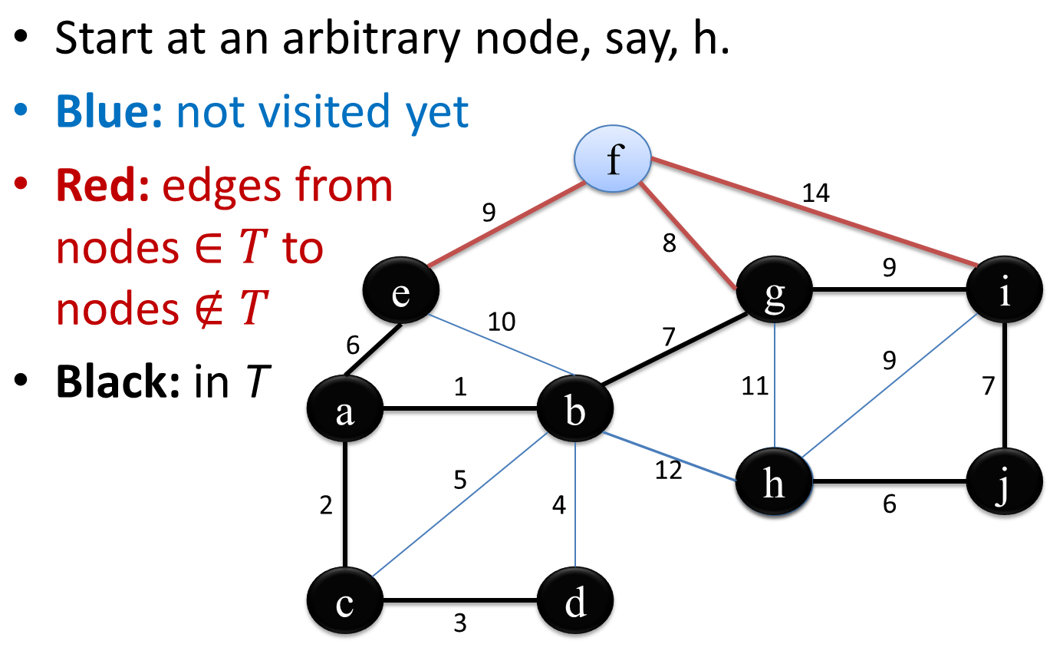
Prim’s algorithm

Slide 21
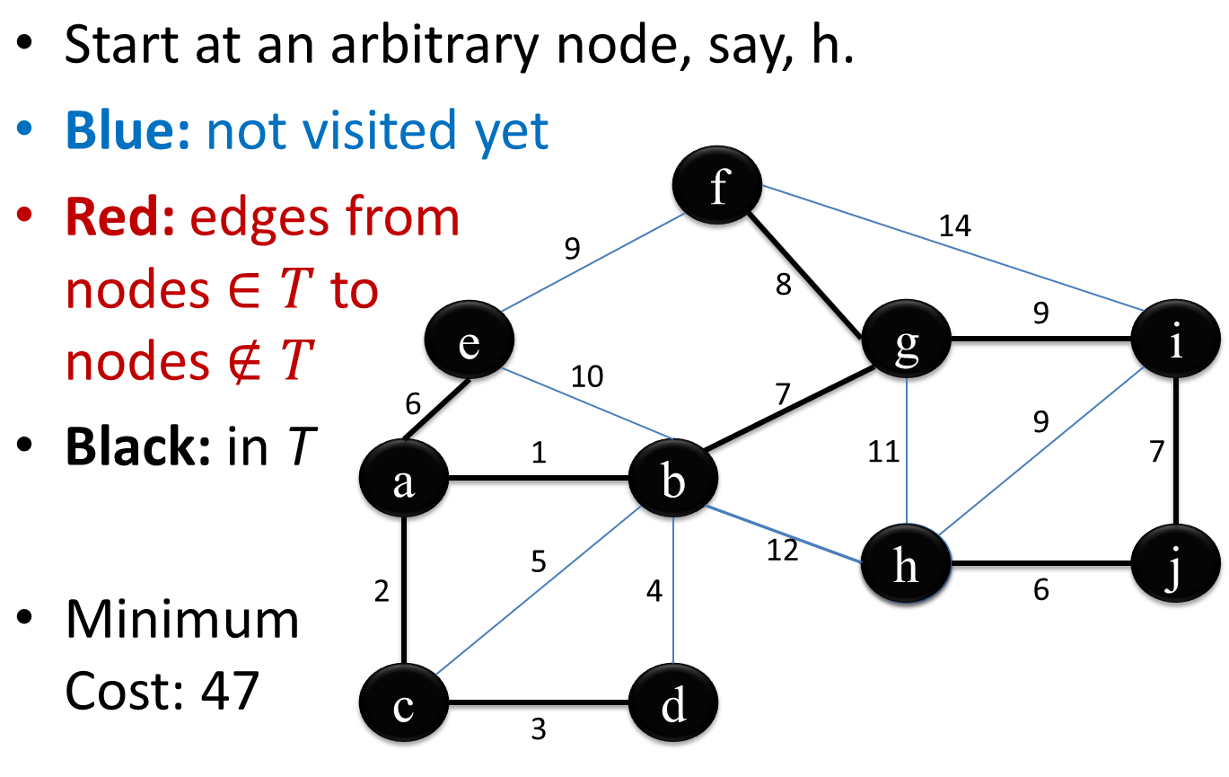
Prim’s algorithm

Slide 22
Prim’s algorithm
A cable company want to connect five villages to their network which currently extends to the market town of Ambattur. What is the minimum length of cable needed?
Baruch
5
Calcutta
3
4
8
6
8
Ambattur
Fatehgarh
Delhi
7
5
4
2
Ellora

Slide 23
Prim’s algorithm

Slide 24
Prim’s algorithm
Note, this example has outgoing edges on the columns and incoming on the rows, so it is the transpose of adjacency matrix mentioned in class. Actually, it is an undirected, so A^{T} = A.
 | A | B | C | D | E | F
A | - | 3 | - | - | 4 | 7
B | 3 | - | 5 | - | - | 8
C | - | 5 | - | 4 | - | 6
D | - | - | 4 | - | 2 | 8
E | 4 | - | - | 2 | - | 5
F | 7 | 8 | 6 | 8 | 5 | -

Slide 25
Prim’s algorithm
Start at vertex A. Label column A “1” .
Delete row A
Select the smallest entry in column A (AB, length 3)
1
 | A | B | C | D | E | F
A | - | 3 | - | - | 4 | 7
B | 3 | - | 5 | - | - | 8
C | - | 5 | - | 4 | - | 6
D | - | - | 4 | - | 2 | 8
E | 4 | - | - | 2 | - | 5
F | 7 | 8 | 6 | 8 | 5 | -
Baruch
3
Ambattur

Slide 26
Prim’s algorithm
Label column B “2”
Delete row B
Select the smallest uncovered entry in either column A or column B (AE, length 4)
1
2
 | A | B | C | D | E | F
A | - | 3 | - | - | 4 | 7
B | 3 | - | 5 | - | - | 8
C | - | 5 | - | 4 | - | 6
D | - | - | 4 | - | 2 | 8
E | 4 | - | - | 2 | - | 5
F | 7 | 8 | 6 | 8 | 5 | -
Baruch
3
Ambattur
4
Ellora

Slide 27
Prim’s algorithm
Label column E “3”
Delete row E
Select the smallest uncovered entry in either column A, B or E (ED, length 2)
1
2
3
 | A | B | C | D | E | F
A | - | 3 | - | - | 4 | 7
B | 3 | - | 5 | - | - | 8
C | - | 5 | - | 4 | - | 6
D | - | - | 4 | - | 2 | 8
E | 4 | - | - | 2 | - | 5
F | 7 | 8 | 6 | 8 | 5 | -
Baruch
3
Ambattur
Delhi
4
2
Ellora

Slide 28
Prim’s algorithm
Label column D “4”
Delete row D
Select the smallest uncovered entry in either column A, B, D or E (DC, length 4)
1
2
4
3
 | A | B | C | D | E | F
A | - | 3 | - | - | 4 | 7
B | 3 | - | 5 | - | - | 8
C | - | 5 | - | 4 | - | 6
D | - | - | 4 | - | 2 | 8
E | 4 | - | - | 2 | - | 5
F | 7 | 8 | 6 | 8 | 5 | -
Calcutta
Baruch
3
4
Ambattur
Delhi
4
2
Ellora

Slide 29
Prim’s algorithm
Label column C “5”
Delete row C
Select the smallest uncovered entry in either column A, B, D, E or C (EF, length 5)
1
2
5
4
3
 | A | B | C | D | E | F
A | - | 3 | - | - | 4 | 7
B | 3 | - | 5 | - | - | 8
C | - | 5 | - | 4 | - | 6
D | - | - | 4 | - | 2 | 8
E | 4 | - | - | 2 | - | 5
F | 7 | 8 | 6 | 8 | 5 | -
Calcutta
Baruch
3
4
Fatehgarh
Ambattur
5
Delhi
4
2
Ellora

Slide 30
Prim’s algorithm
FINALLY
Label column F “6”
Delete row F
1
2
5
4
3
6
 | A | B | C | D | E | F
A | - | 3 | - | - | 4 | 7
B | 3 | - | 5 | - | - | 8
C | - | 5 | - | 4 | - | 6
D | - | - | 4 | - | 2 | 8
E | 4 | - | - | 2 | - | 5
F | 7 | 8 | 6 | 8 | 5 | -
Calcutta
Baruch
3
4
Fatehgarh
Ambattur
5
Delhi
4
2
Ellora

Slide 31
Prim’s algorithm
1
2
5
4
3
6
FINALLY
Label column F “6”
Delete row F
 | A | B | C | D | E | F
A | - | 3 | - | - | 4 | 7
B | 3 | - | 5 | - | - | 8
C | - | 5 | - | 4 | - | 6
D | - | - | 4 | - | 2 | 8
E | 4 | - | - | 2 | - | 5
F | 7 | 8 | 6 | 8 | 5 | -
Calcutta
Baruch
3
4
Fatehgarh
Ambattur
5
Delhi
4
The spanning tree is shown in the diagram
Length 3 + 4 + 4 + 2 + 5 = 18Km
2
Ellora

